Slide 1
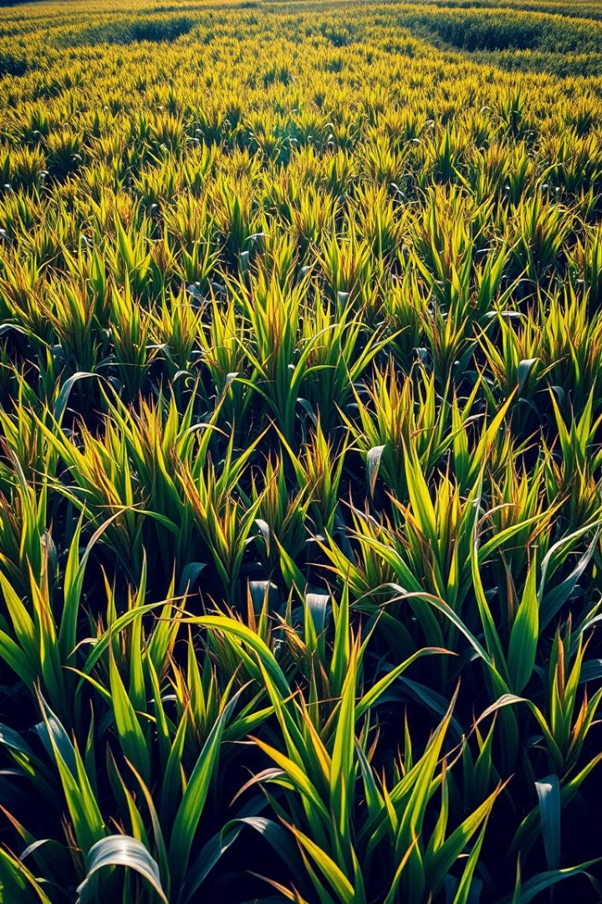

SEEDS OF CHANGE: Democratizing Agricultural Investment in India
This presentation outlines a revolutionary approach to agricultural investment in India, utilizing blockchain technology to empower farmers and attract investors, transforming the sector into a sustainable and profitable ecosystem.

Slide 2
SEEDS OF CHANGE
Abhishek Kumar Pandey MDB23001
Hrishabh Shukla MDB23002
Mungamurugu Pavan Kumar MDB23003
Priyanshu Dubey LCB2021003
Utkarsh Pawar LCB2021032
Rushi Mahajan LCB2021035

Slide 3
Understanding Blockchain
Decentralized Ledger
Transformative Potential
Blockchain is a decentralized digital ledger that records transactions transparently and securely. It eliminates the need for intermediaries, ensuring data integrity and trust.
This technology can transform traditional systems by introducing transparency, efficiency, and accountability, fostering trust and collaboration.

Slide 4
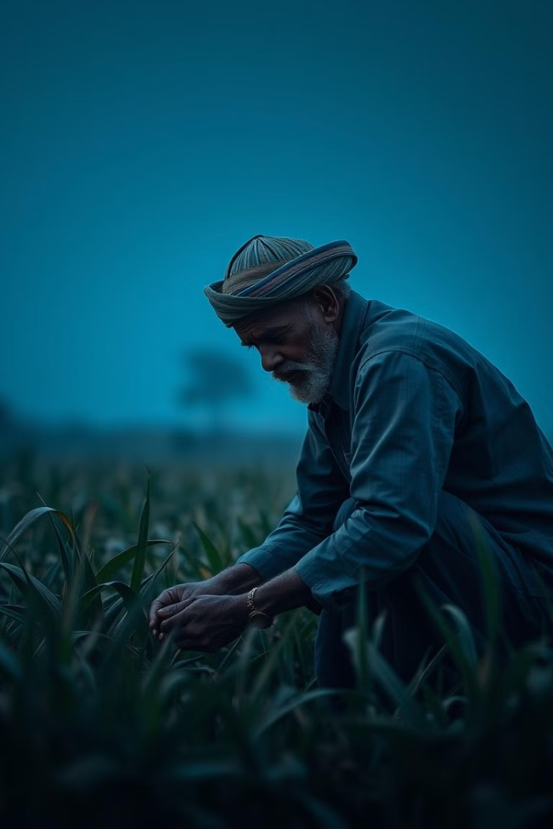
Challenges in Indian Agriculture
Lack of Funding
Exploitation by Intermediaries
Farmers often rely on high-interest loans from informal sources, leading to debt traps. Despite government efforts, financial access remains limited.
A long supply chain reduces farmer profits, with middlemen taking a significant share of revenue.
Risks in Traditional Farming
Farmers face unpredictable weather, market price volatility, and lack of crop insurance. Without access to real-time data, decision-making becomes reactive rather than proactive.

Slide 5
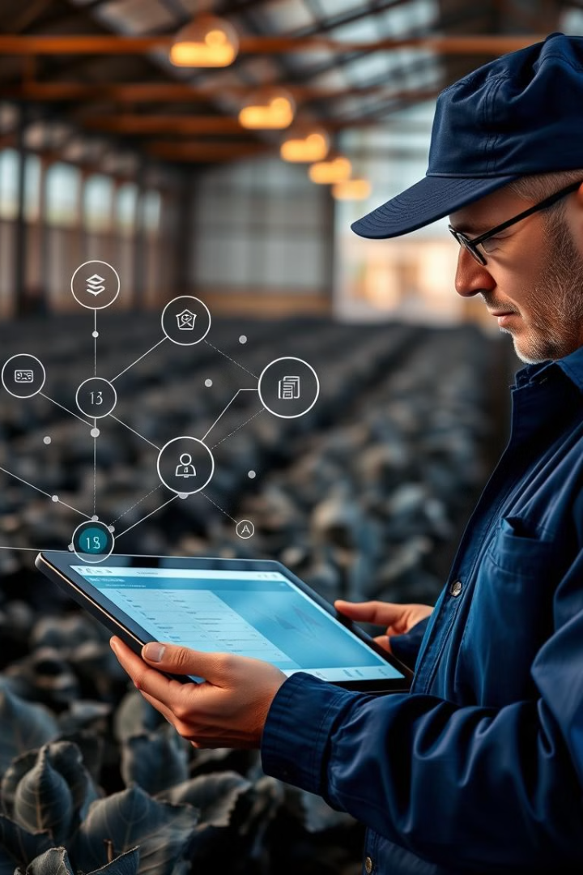
Blockchain: A Solution for Indian Agriculture
1
Transparency
2
Accountability
Real-time tracking of farming processes, from sowing to harvesting, provides visibility to all stakeholders.
Immutable records ensure that funds are used for intended purposes, fostering trust and eliminating fraud.
3
Access to Capital
Tokenization enables fractional ownership, encouraging investments from individuals and institutions, expanding funding options for farmers.

Slide 6
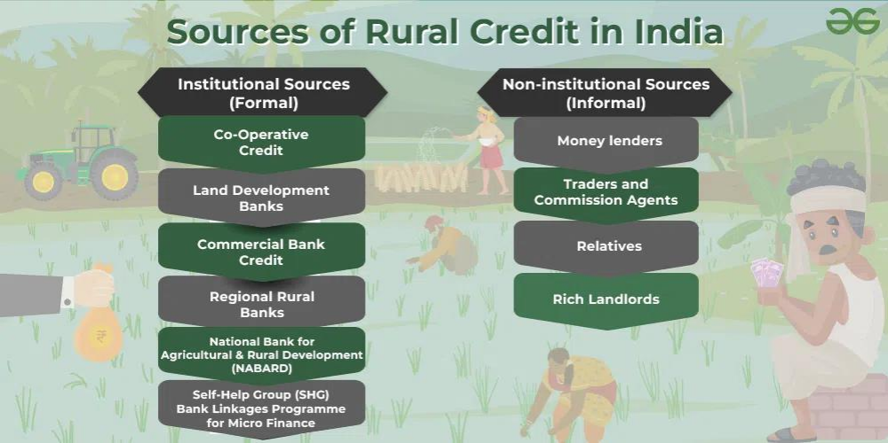

Slide 7
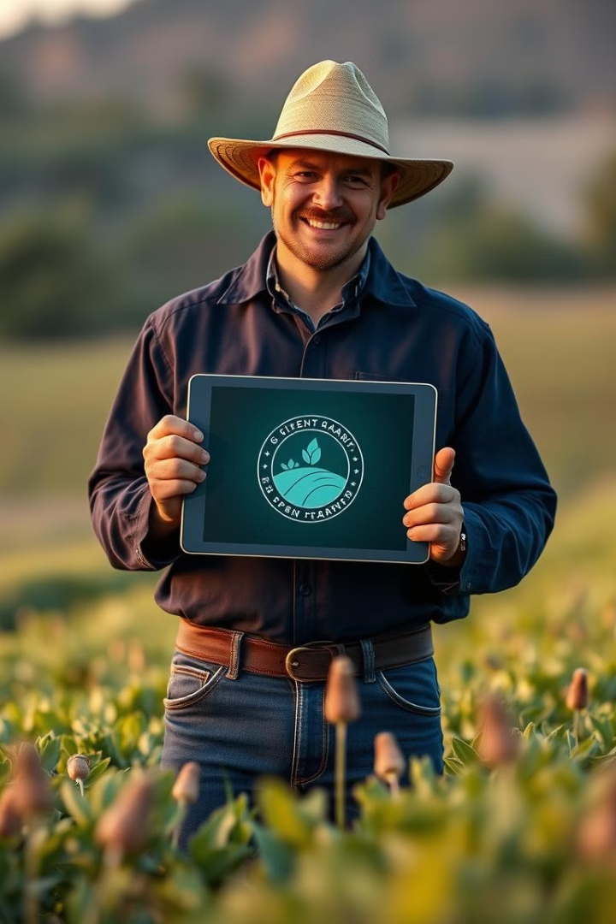



Tokenization: Empowering Farmers as Entrepreneurs
Reduced Dependency
Tokenization reduces dependency on traditional loans, providing farmers with alternative funding sources.
Empowerment
Farmers retain ownership and act as entrepreneurs, using the raised funds to grow crops and share profits with investors.
ESG Investment
This approach attracts ESG (Environmental, Social, Governance)-focused investments, promoting sustainable agricultural practices.

Slide 8
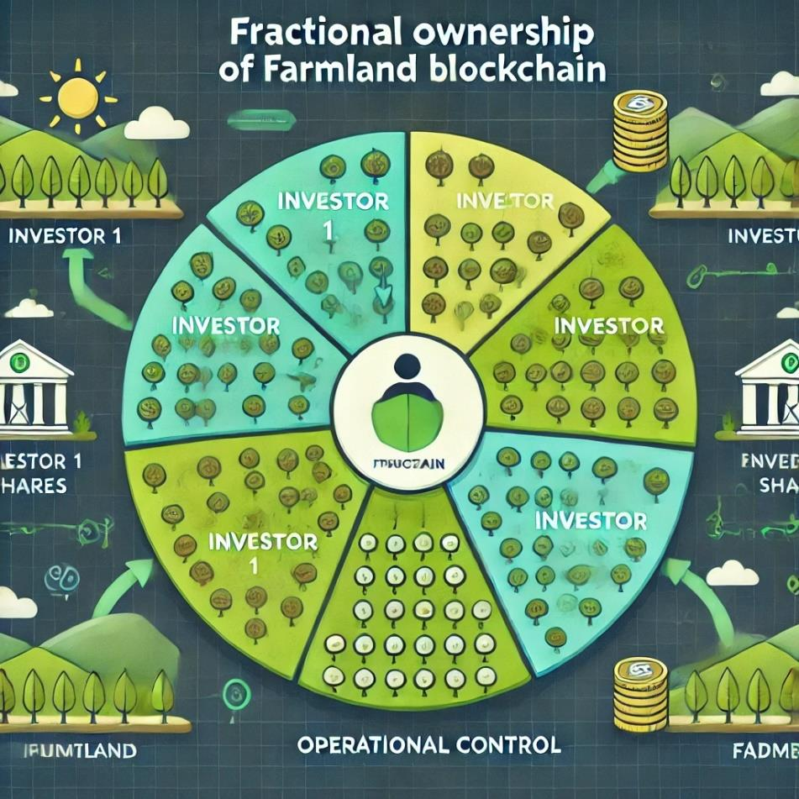

Slide 9
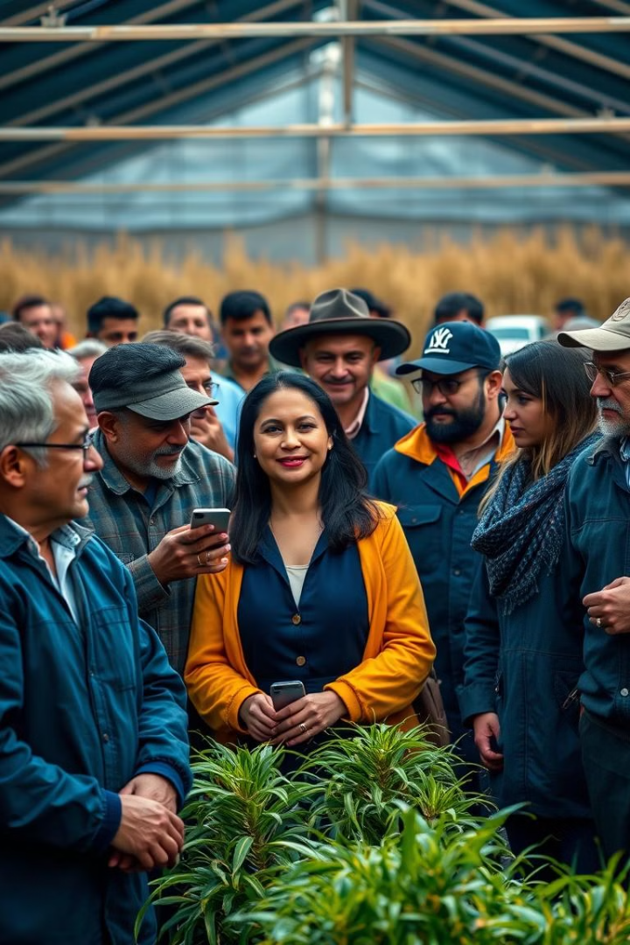
Blockchain in Agriculture and Financial Inclusion
1
Fractional Ownership
Farmlands can be tokenized into digital shares, making investments more accessible to a wider range of individuals and institutions.
2
Direct Financial Access
Blockchain eliminates intermediaries, reducing costs and ensuring funds are directly transferred to farmers, promoting financial inclusion.
Empowering Smallholders
3
Small and marginal farmers, who lack collateral, gain an alternative route to funding through shared ownership models.

Slide 10




Technology Stack: Enabling Transparency and Efficiency
Blockchain Platform
Ethereum (or similar platforms like Binance Smart Chain or Polygon) provides a secure and robust infrastructure for smart contracts and tokenization.
Smart Contracts
Automated agreements define investment terms, payouts, and penalties, ensuring transparency and compliance.
Real-Time Monitoring
IoT integration collects real-time data on soil health, crop growth, and weather, providing valuable insights and enhancing decision-making.

Slide 11
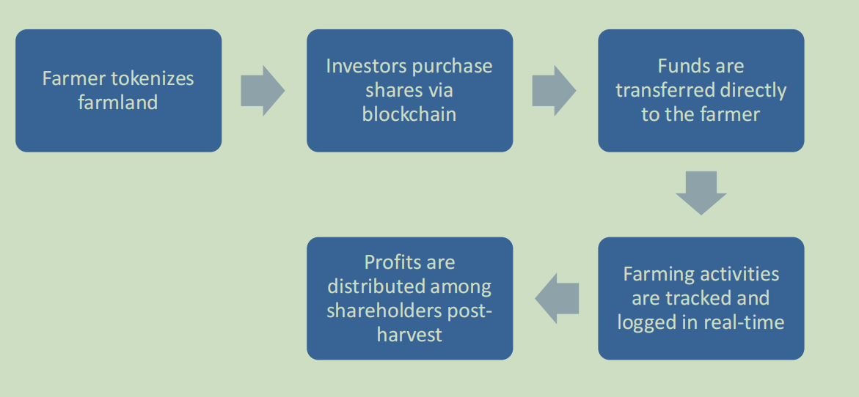

Slide 12
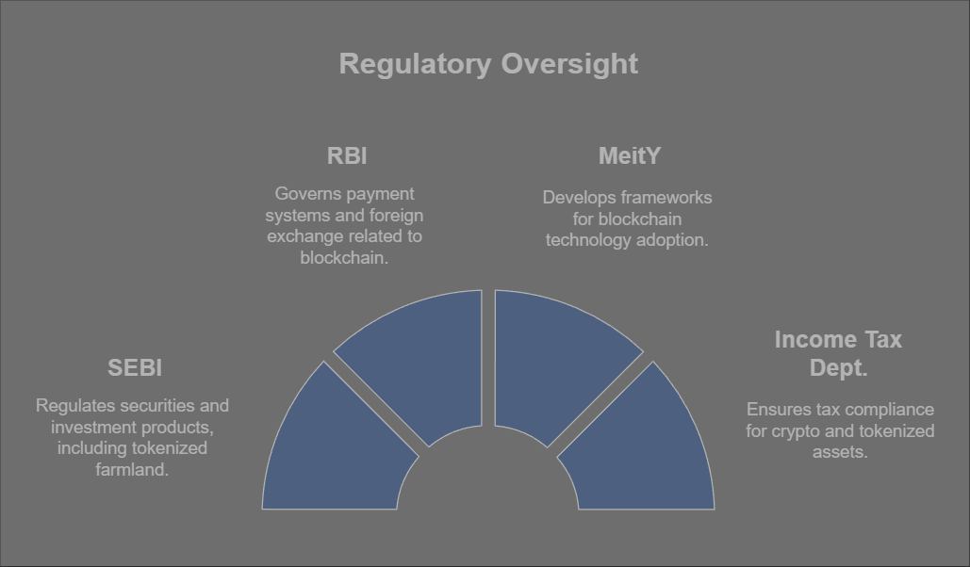

Slide 13
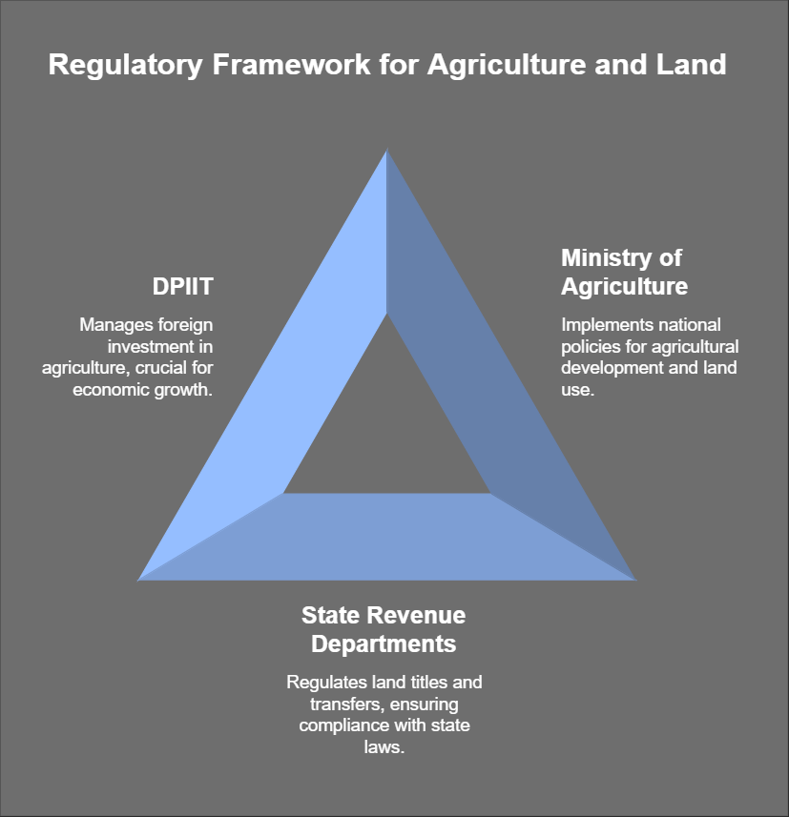

Slide 14
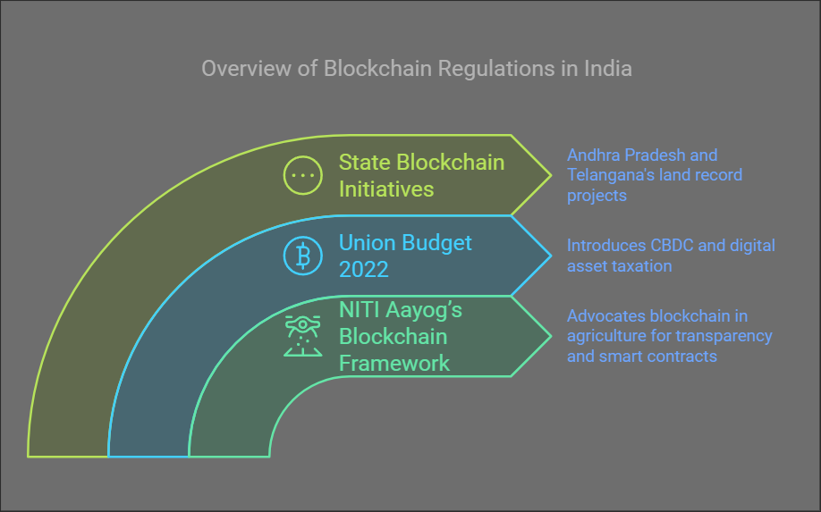

Slide 15
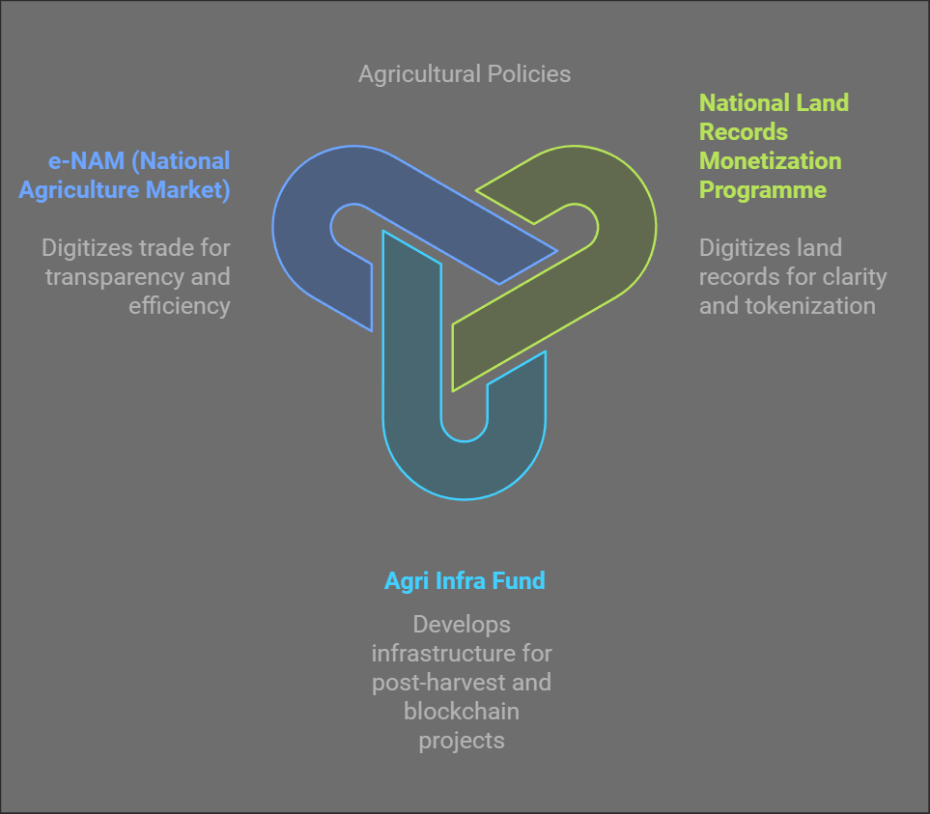

Slide 16
TECHNOLOGY: Detailed Architecture

Slide 17
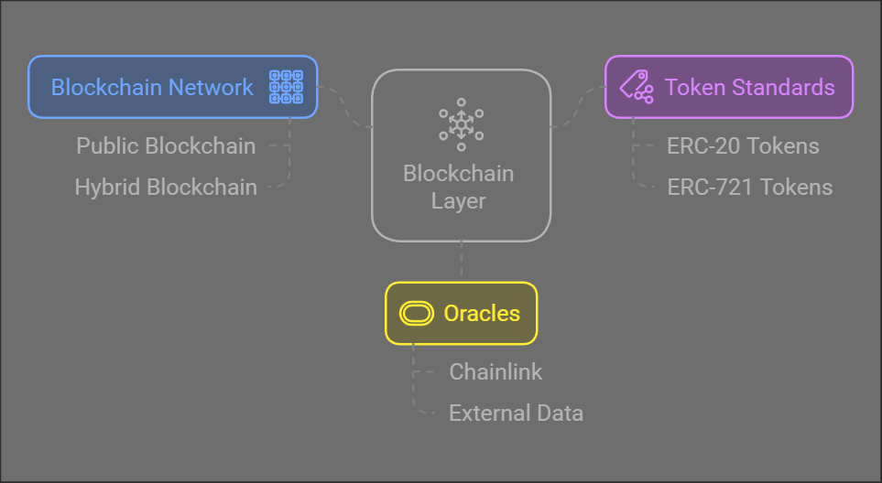

Slide 18
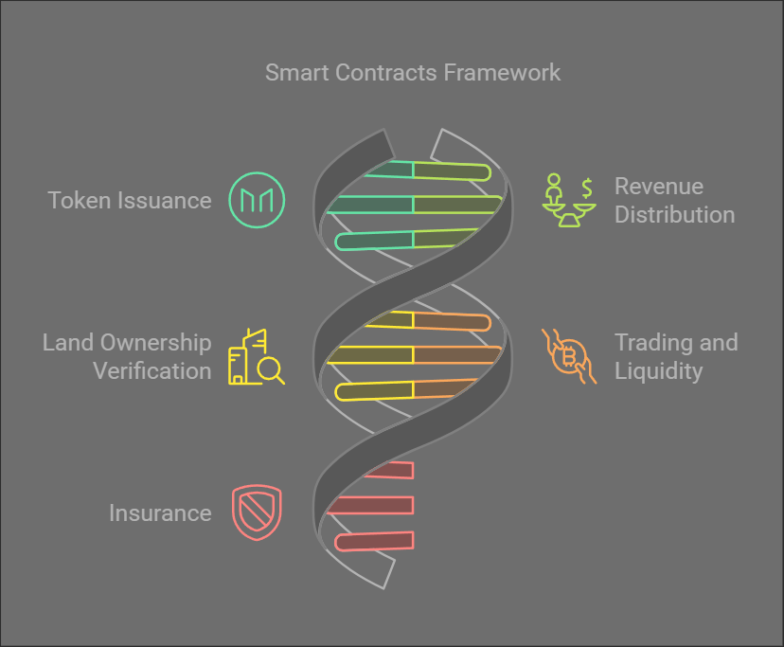

Slide 19
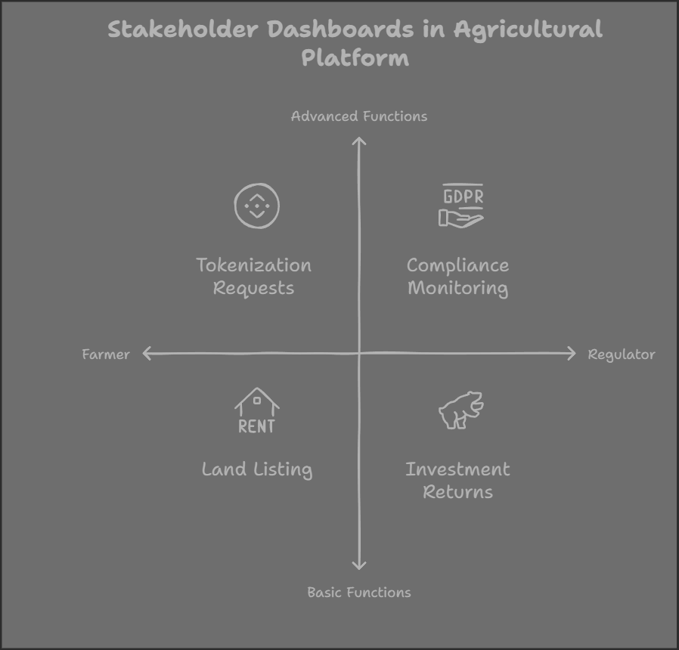

Slide 20
Estimating the Overall Potential Market Size
Agricultural Market in India:
Current Farmland Value:
India has approximately 160 million hectares of arable land, with an average value of ₹20-50 lakhs/acre depending on location.
Estimated value: ₹350-500 trillion ($4.2–6 trillion).
Potential Market for Tokenization:
Assuming 10% tokenizable farmland (based on ownership and title clarity):
Market size = ₹35–50 trillion ($420–600 billion).
Market Opportunity:
Targeted Fractional Investments:
1% market penetration in the first five years = ₹350 billion ($4.2 billion) in tokenized assets.

Slide 21
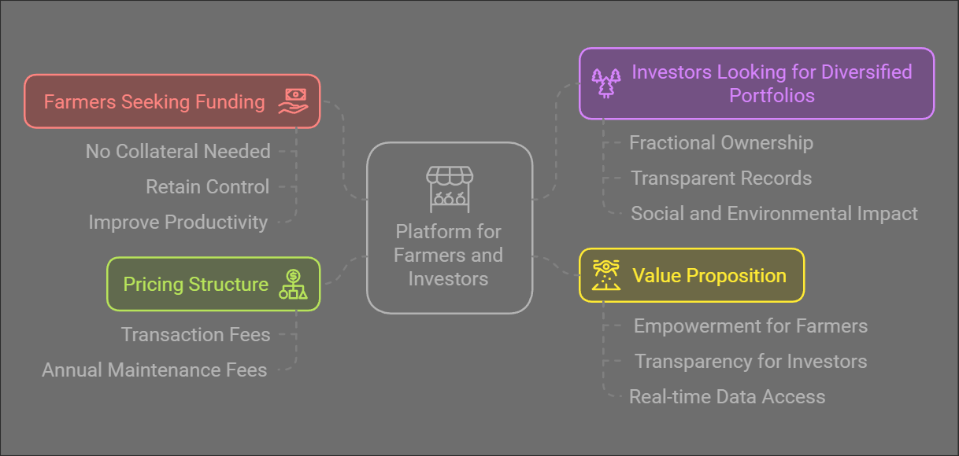
Target Users and Value Proposition

Slide 22
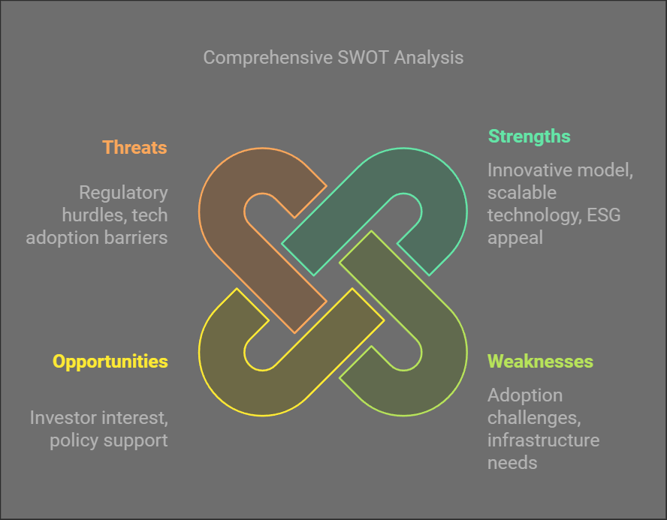

Slide 23
!! THANK YOU !!

